Slide 1
Capstone Project
Airbnb Booking Analysis

Slide 2
CONTENT
Analysis Based on
● Price
● Neighbourhood Group
● Neighbourhood
● Host
● Room type
● Names
Area wise distribution
● Room type booked according to region
● Availability of room type
Challenges
Conclusion

Slide 3
Problem Statement
● Analysis Based on Price
● Analysis based on neighbourhood group
● Analysis based on neighbour
● Analysis based on area presence
● Analysis based on Names

Slide 4
Data Summary
Dataset Name :- Airbnb dataset for US based New York city.
Shape :-
● Rows - 48895
● Columns -16
Important Columns :- Name, Neighbourhood group, Neighbourhood, Host ID, Room type, Price, Minimum Night Stayed

Slide 5
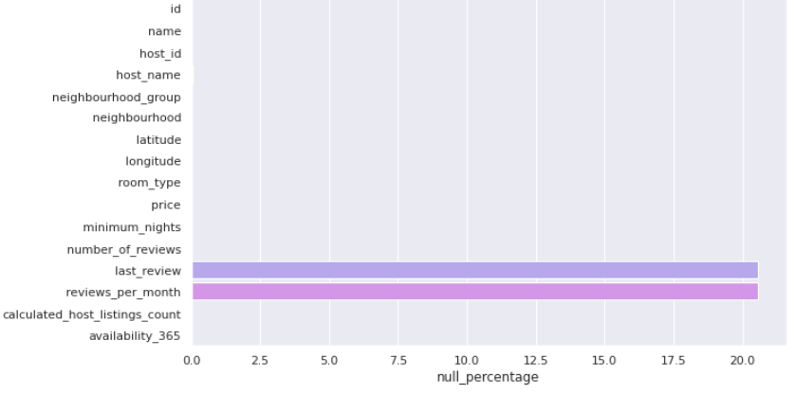
Null Values

Slide 6
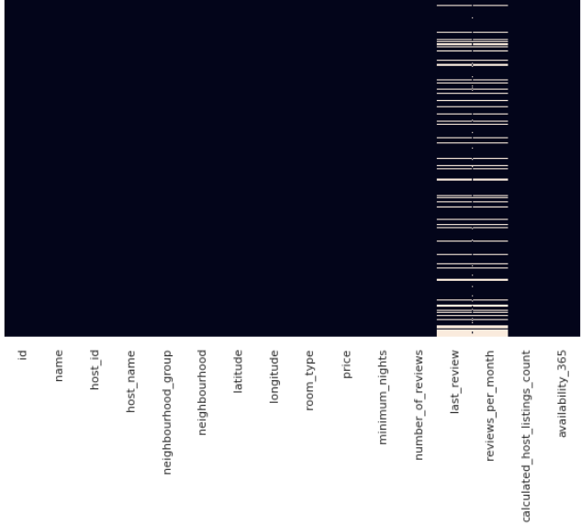
Null value Imputation

Slide 7
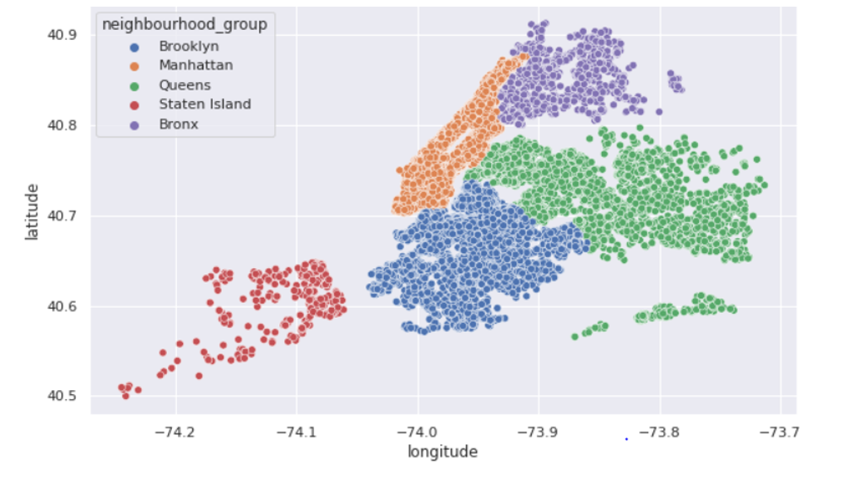
Where these Neighbourhood Group are present?

Slide 8
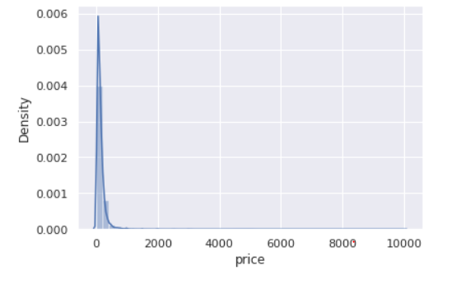
Price

Slide 9
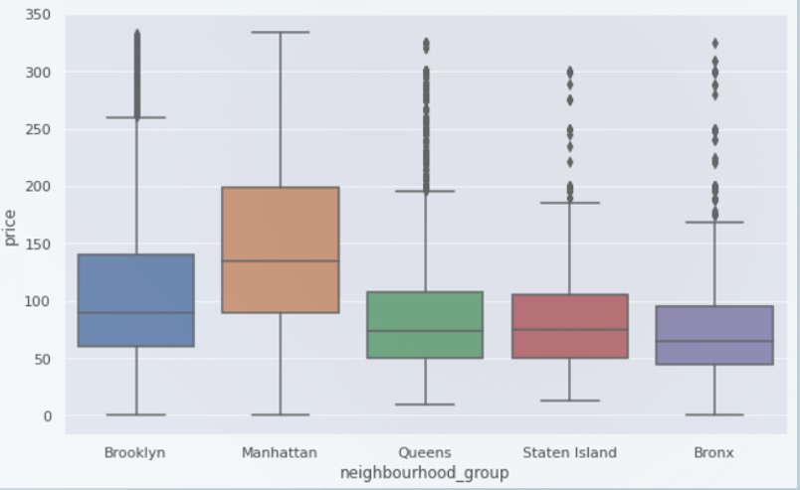
Price Variation with Neighbourhood group

Slide 10
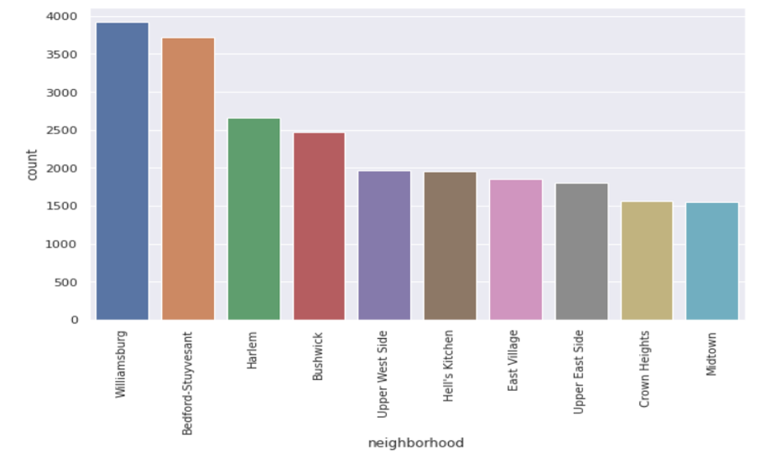
Top 10 Neighbourhood

Slide 11
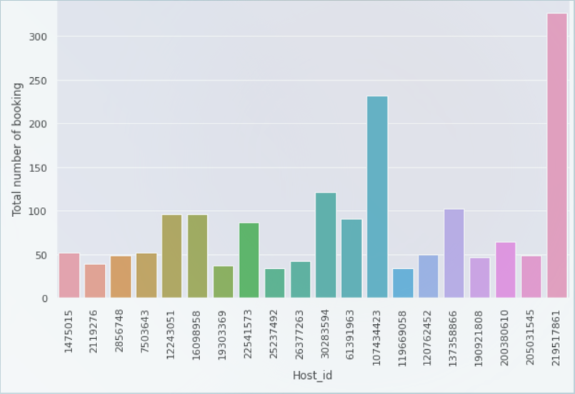
Top 10 host id

Slide 12
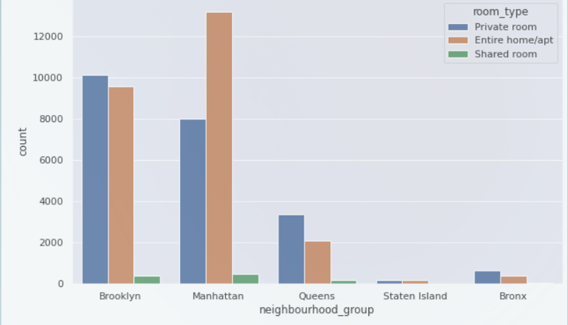
Which room type is preferred in neighbourhood group?

Slide 13
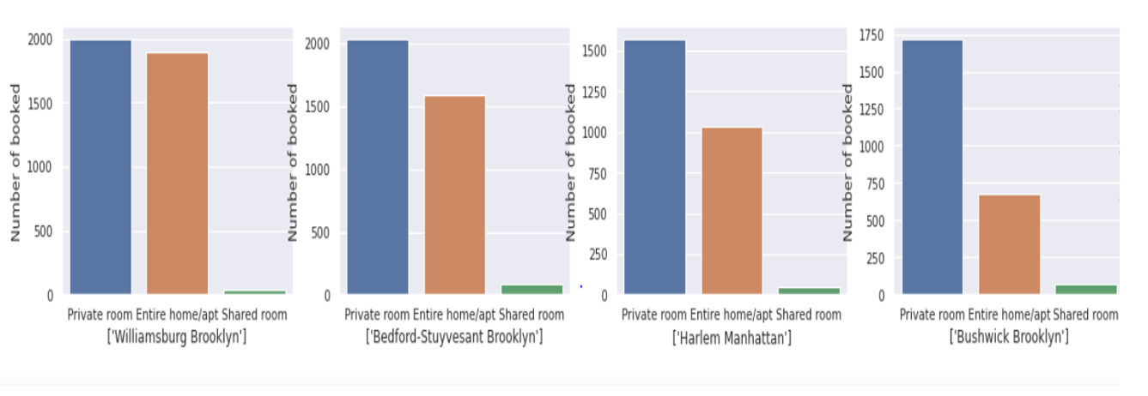
Top 4 neighbourhood preferred room type

Slide 14
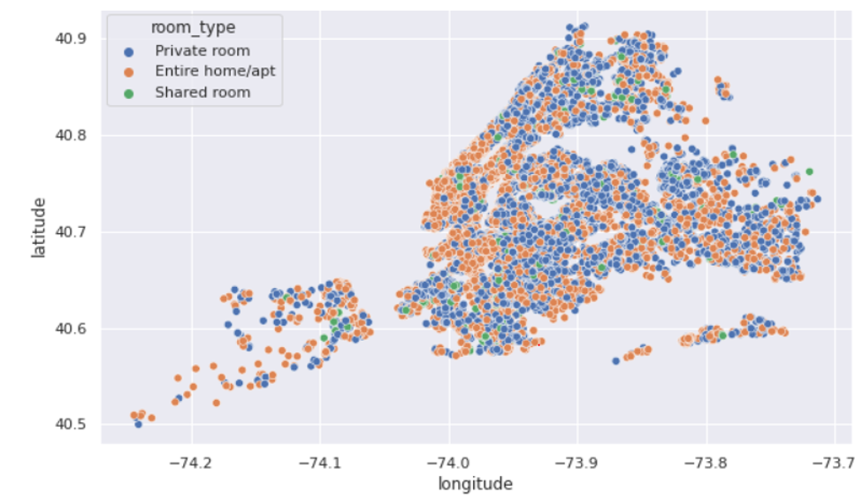
Room Type in Different Region

Slide 15
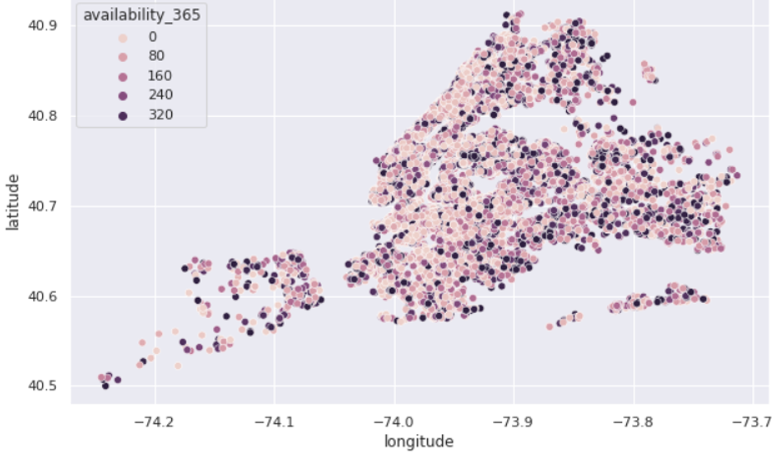
Availability per location

Slide 16
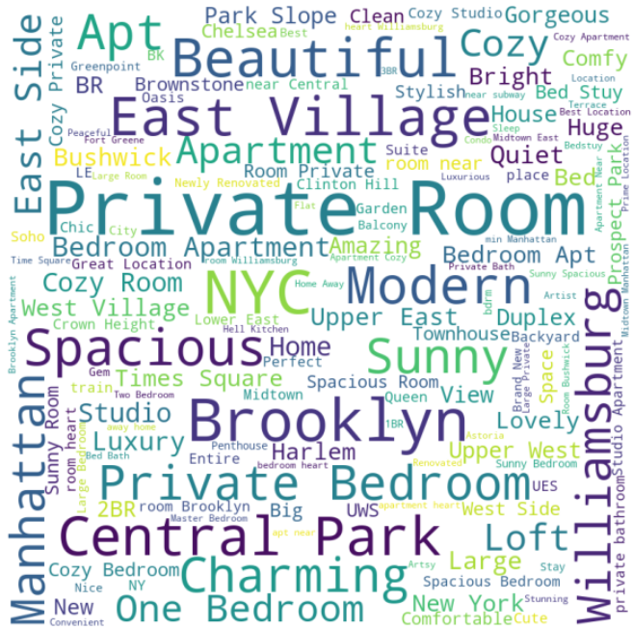
Word Present in the Name

Slide 17
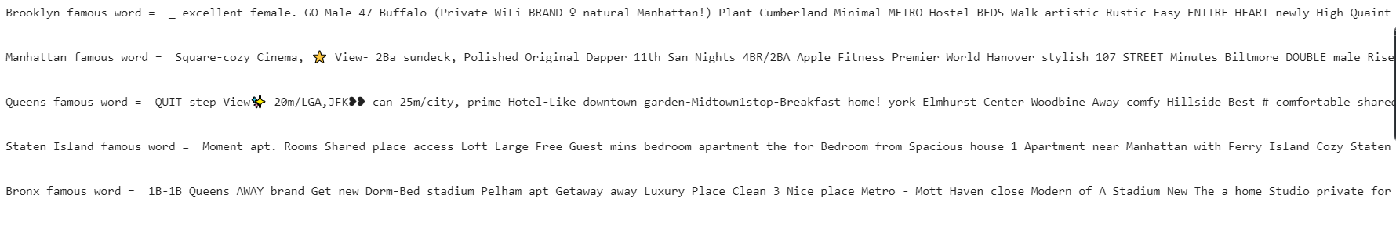
Words present in Neighbourhood Group

Slide 18
Challenges
● Nan values in one of important column of review date.
● Difficulty in extracting the information from the words.

Slide 19
Conclusion
1. Manhattan is most busy place followed by Brooklyn and Queens, Bronx, Staten Island.
2. Most of the neighbourhood are from Brooklyn and Manhattan in top 10.
3. Highest no. one host booked as 325 which is from Manhattan
4. In overall people are preferring separate room but in Manhattan people are buying flats.
5. People are tend to stay for longer period in Manhattan and Brooklyn.
6. Prices are showing variation other than Manhattan.

